Slide 1


Week 5 Mini-Strategy
Team E: Rozell Ritemon, Nate Bachmeier, Sarita Dickens
STR/581
Edgar Coronel
3/5/2017

Slide 2
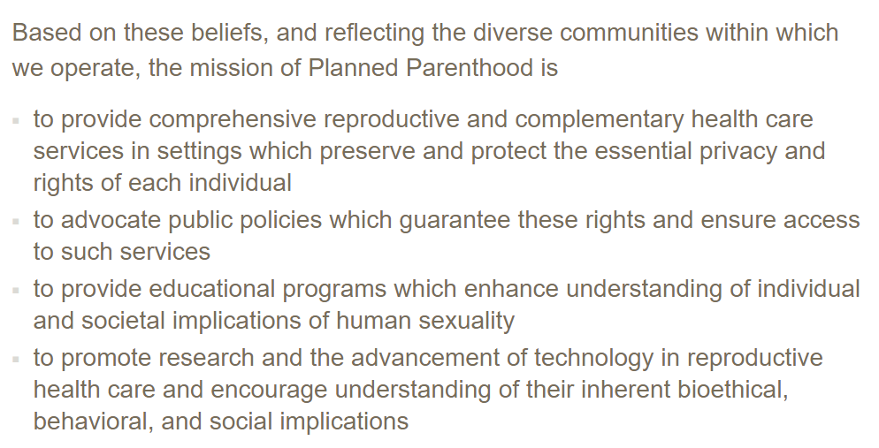
The organization's mission statement vision statement, values statement
Notes:
Plan Parenthood’s mission is to provide universal access to reproductive health services. This is done as a non profit organization which is maintained through donations to the business.
From their mission statement, comes their vision statement which is a world where everyone can get the information and help they need about reproductive issues. This comes with giving the power of educated choice to the individual, irrespective of who they are. https://www.plannedparenthood.org/about-us/who-we-are/mission

Slide 3
Discuss the organization's current goals and objectives
Provide high quality health care
Prevent unintended pregnancies
Lobby for the rights of their clients
Raise enough donations they can help low income as well as high income
Notes:
The nonprofits goals and objectives follow a similar direction as their mission statement. These center around providing the best service available. They also want to interact with as many people as possible, and this is done through donations and other fund raising.
Another area of concern is that unintended pregnancies can have negative impacts on both the infant and their parents. To mitigate these risks the organization provides birth control solutions and education to any who need it. They also lobby for the removal of restrictions which prevent their clients from having the ability to control their pregnancies.

Slide 4
Conduct a basic SWOTT analysis and discuss the implications of those results
Strengths: Strong Brand
Weaknesses: Nonprofit
Opportunities: Expand into new markets
Threats: Political uncertainty
Notes:
The biggest strength of Planned Parenthood is their brand, which is well known. They can easily associate themselves with charity events and raise capital from a large corpus of individuals.
One of their weaknesses is being a nonprofit organization. This limits the methods available to raise capital such as selling equity or debt to share holders.
An opportunity for the business would be to expand into new international markets. For example, there could be value for people in developing countries to have these same resources.
A key threat to the business is political uncertainty. Some politicians make reproductive issues about religion instead of biology. This causes legislation which can complicate the organizations efforts.

Slide 5
Perform competitor analysis Affordable Care Act
Other Legislation
Existing Hospitals and Clinics
Notes:
The competition comes from primarily two different vectors, legislation and other clinics.
Governmental legislation, such as the Affordable Care Act, have reduced the costs required to gain access to reproductive services. As the price drops the need to deviate from a primary health insurance policy diminishes.
The other source is existing clinics, such as general and urgent care facilities. These places have the ability to offer general medical assistance in addition to reproductive help. That enables the competitor to be more integrated into their patents lives. As the level of integration increases the need for a substitute is diminished.

Slide 6
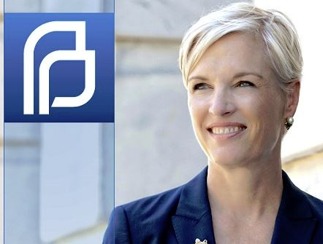

Planned Parenthood’s Leadership:
Cecile Richards, President & CEO
Other Executive Team Members:
Melvin Galloway, Executive Vice President & Chief Operating Officer
Dawn Laguens, Executive Vice President & Chief Brand Officer
Kim Custer, Executive Vice President, Health Care
Latanya Mapp Frett, Vice President of Global Programs
Danette (Danni) Hill, Chief Human Resources Officer
Jethro O. Miller, Chief Development Officer
Tom Subak, Chief Strategy Officer
Wallace D’Souza, Chief Financial Officer
Debra Alligood White, Senior Vice President & General Counsel
Raegan McDonald-Mosley, MD, MPH, FACOG, Chief Medical Officer
Franklin Rosado, Chief Technology Officer
Notes:
The first slide within the assessment of the Planned Parenthood’s organization is a look into its leadership.

Slide 7

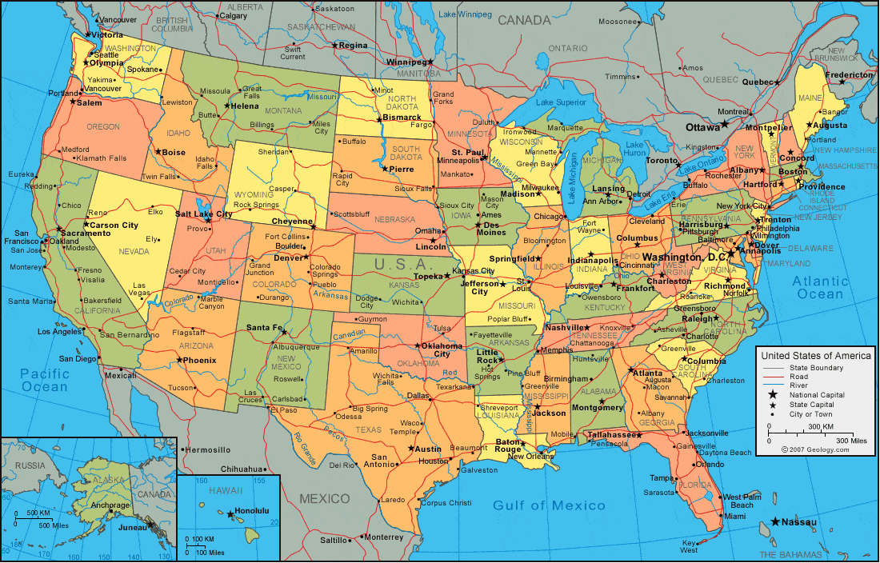
Planned Parenthood’s Board members:
Planned Parenthood has directors in each state it services; they all serve as a conglomerate force towards the organizations'’ key initiatives.
Notes:
Planned Parenthood has board members in many different locations, which all contribute to the strategic planning and guidance of the organization.

Slide 8

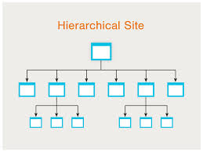
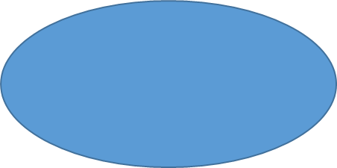

Planned Parenthood’s Structure:
Board Members
Chief Officer
Planned Parenthood utilizes a hierarchical organizational structure
Officer
Officer
Officer
Notes:
Planned Parenthood’s has a hierarchical organizational structure, in which it operates within. The chain of influence begins with the board and is passed down to the CEO, before conveyed to the necessary officer(s).

Slide 9


Planned Parenthood’s Number of Employees:
“Planned Parenthood has 56 independent local affiliates that operate nearly 650 health centers throughout the United States, providing high-quality services to women, men, and teens.”
It is unclear as to the exact amount of employees Planned Parenthood has. Yet, with independent facilities and other centers of service there are sure to be hundreds, if not, thousands of employed participants.
Notes:
Planned Parenthood has many partnerships and affiliations, which makes it difficult to determine the exact number of actual employees at any given times, yet, estimates may be measurable given the proper data.

Slide 10
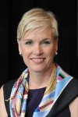
Notes:
CEO since “2006” Cecile Richards is a married to Kirk Adams and the mother of three children. She was born in Waco, Texas and has a strong background in taking political stances for what she believes in.

Slide 11
CEO Profile
Background and Career Accomplishments
Board of the Ford Foundation
Founder of America Votes
Worked at the Turner Foundation
Founded the Texas Freedom Network
Serves as a Deputy Chief of Staff for House Democratic leader Nancy Pelosi
Founded and served as President of America Votes

Slide 12
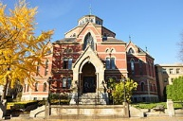
CEO Profile Education
Notes:
Cecile attended Brown University in Providence Rhode Island and graduated with a Bachelors Degree in “1980”. Although she does not have any other formal education the experience and knowledge that she has learned hands on fighting for what she believes in has helped her to accomplish all of her goals. These experiences has also allowed her to demonstrate her passion for helping people.

Slide 13
Reference
Planned Parenthood Federation of America Inc. (2017). Planned Parenthood at a Glance. Retrieved from:https://www.plannedparenthood.org/about-us/who-we-are/planned-parenthood-at-a-glance
http://www.plannedparenthood.org
https://www.thenation.com/article/genius-cecile-richards https://www.plannedparenthood.org/about-us/who-we-are/mission

